Slide 1
Dynamics of Oscillating Water columns
Siddharth Jain – Aerospace Department, VT

Slide 2
Contents
Defining Problem Statement
Equation Derivation
FBD / Diagram / Equation of Motion
Stiffness Matrix / Mass Matrix / Proportional Damping
Analysis from Eigenvalue Problem
Computing lambda, natural frequencies, finding zeta
Mode Shapes
Response
Free Vibration
Forced Excitation variations
Using Modal Analysis
Advantages of Modal Analysis over direct formulations
Lessons learnt
Proof of Concept

Slide 3
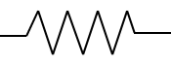
Problem Statement
6 Degree of Freedom
Alternate harmonic excitation
Combined stiffness of spring and strings
Proportional Damping
F₁ (t)
F₃ (t)
F₅ (t)
F₂ (t)
F₄ (t)
F₆ (t)
k₁
k₃
k₅
k₂
k₄
k₆

Slide 4
Motivation / Idea behind the project
Renewable energy and is the largest estimated global resource form of ocean energy. Green and reliable energy. Thus important thing to study!
Wave energy has a lot of potential.
Ocean waves are one of the best example of a dynamics problem where one can model different types of excitations and compute their responses accordingly.
Disadvantage – Development and maintenance cost.

Slide 5
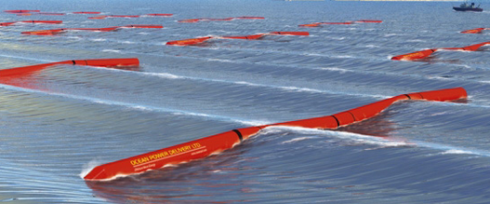
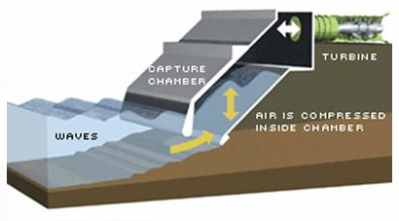
Technologies
There are multiple different techniques used for harvesting Wave energy.

Slide 6
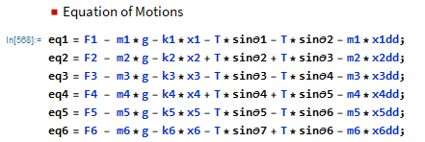
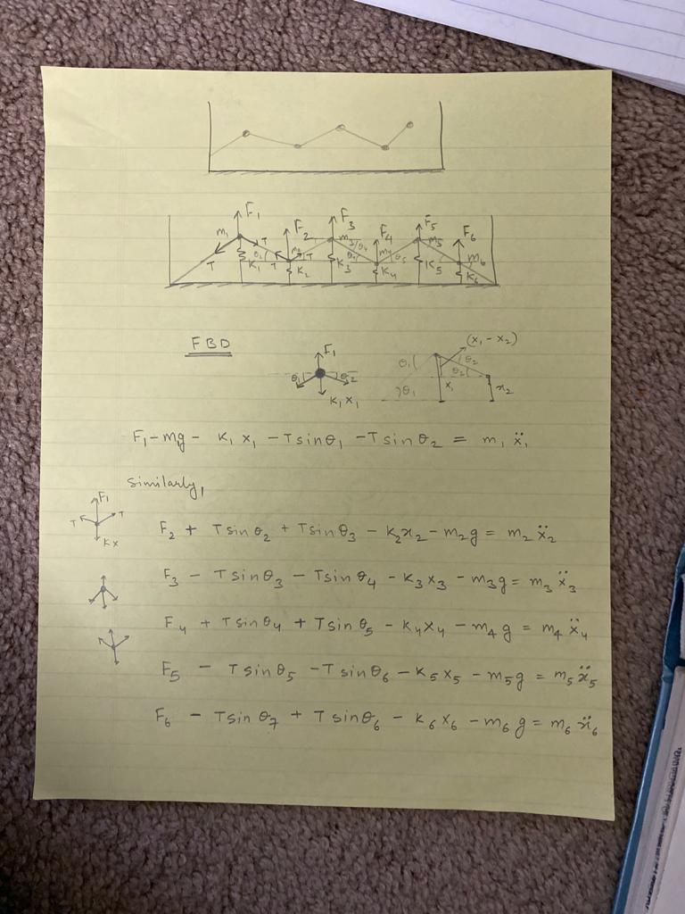

Equation of Motion
F1
m1
θ1
θ2
T
T
Similarly after analyzing all the Free body diagrams, equations are written in Mathematica for easy computation
K1*x1
Equations verified using Energy Method

Slide 7
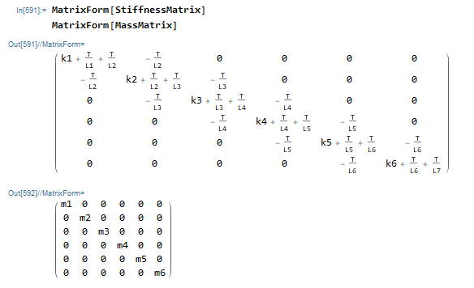
Stiffness Matrix and Mass Matrix

Slide 8
Proportional Damping
C = α*M + β*K
Linear combination of mass and stiffness matrices.
α, β are the constant scalers.
α + β*ω² = 2*zeta*ω, where ω is the natural frequency

Slide 9
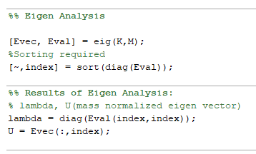
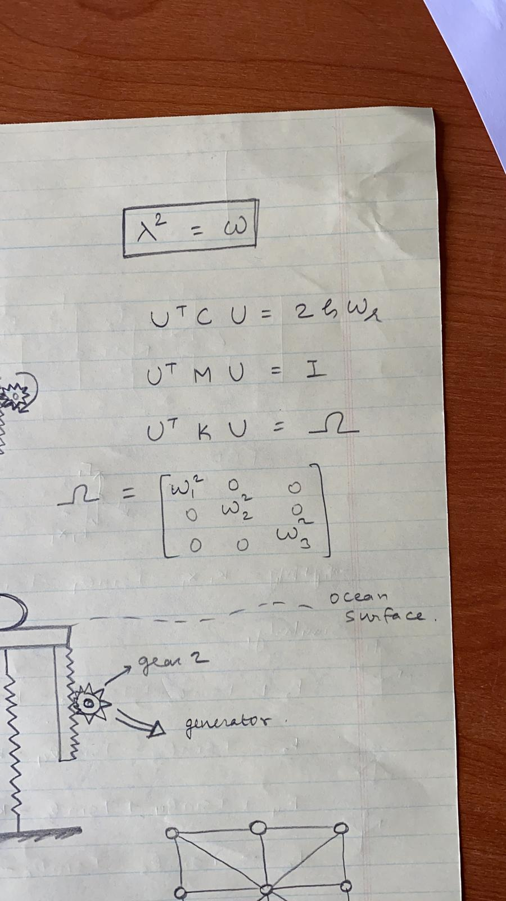
Eigen Value Analysis
Formulas used for producing eigen values and eigen vectors along with matlab code

Slide 10
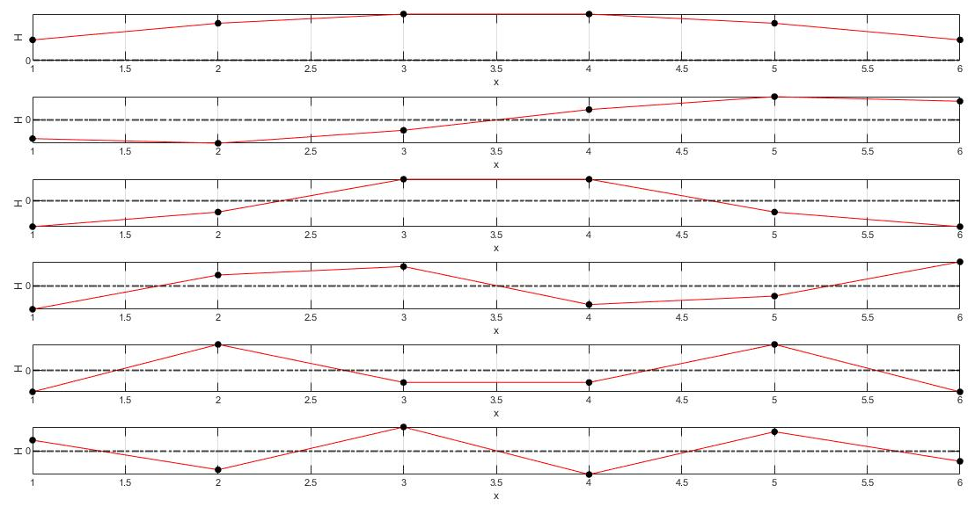
Mode Shapes

Slide 11
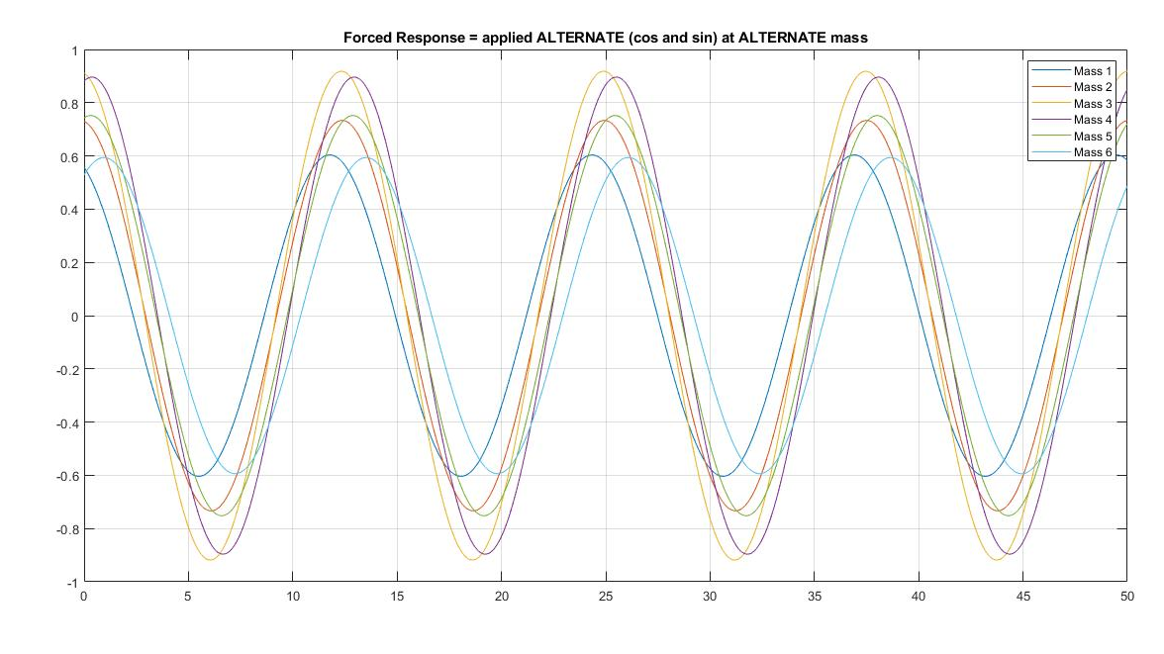
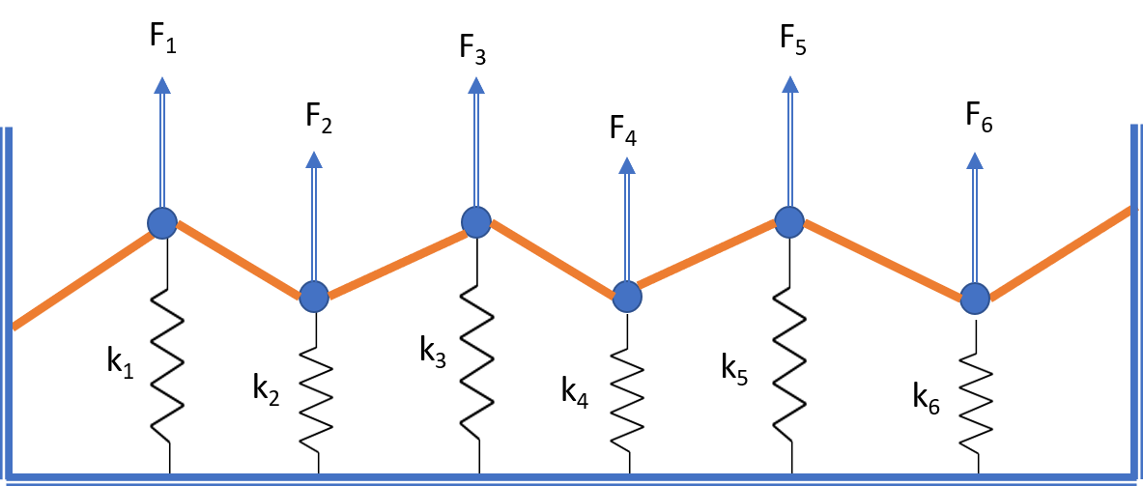
Forced Excitation
F1 = Cos(wt)
F2 = Sin(wt)
F3 = Cos(wt)
F4 = Sin(wt)
F5 = Cos(wt)
F6 = Sin(wt)

Slide 12
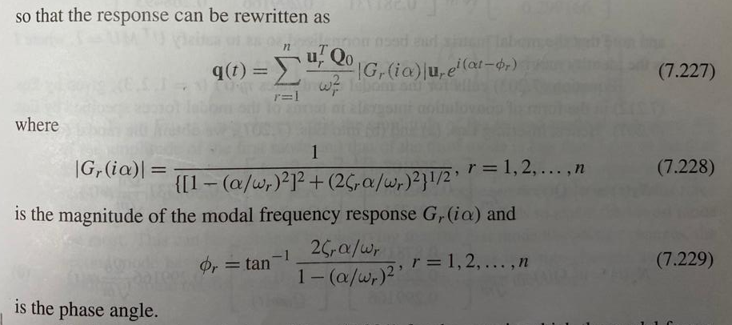
Formulation Used
where U is the eigen vector for r^{th} mode
Q0 is the amplitude of the Forcing Excitation
α is the excitation frequency

Slide 13
Observations
Since it is hard to predict damping from the steady state response there is a need to plot free vibration response.
As advised by Dr. Gary Seidel, in order to check for damping to work try to plot the initial free vibration response

Slide 14
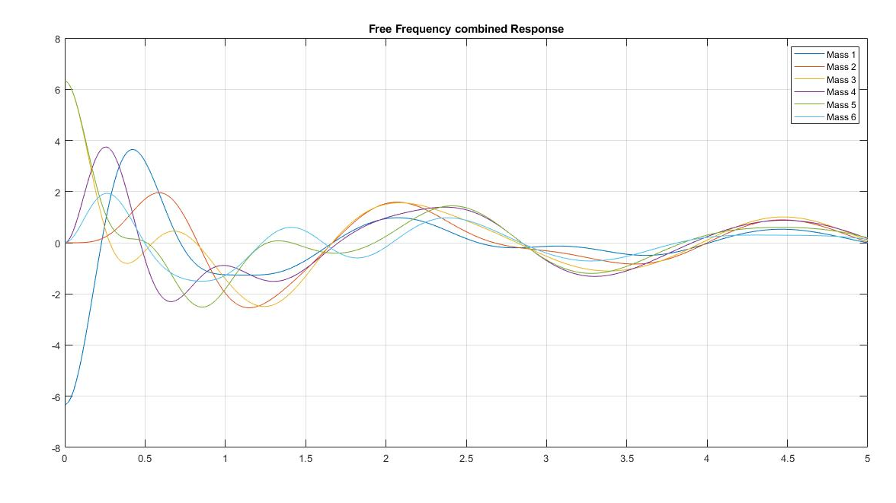
Free Vibration combined response

Slide 15
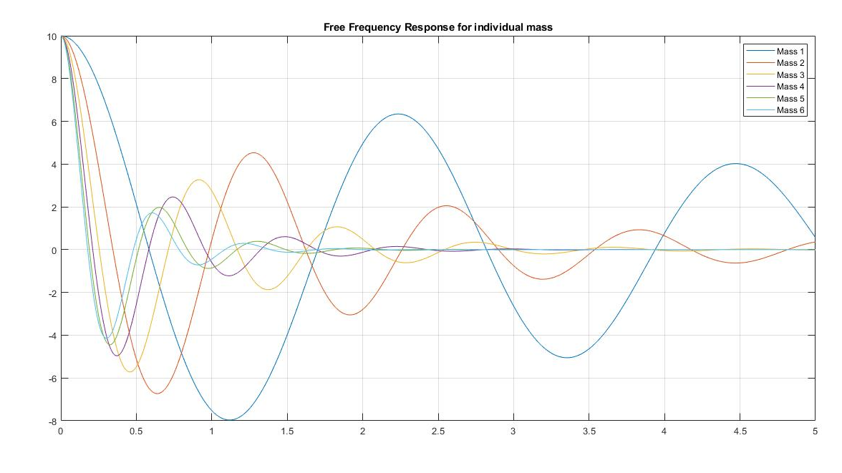
Free Vibration response for individual mass

Slide 16
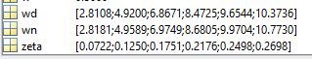
Observations
We can easily see that there is damping going on in the system.
Then why it is to difficult to observe it in the steady state responses
at
α = 0.01
β = 0.05

Slide 17
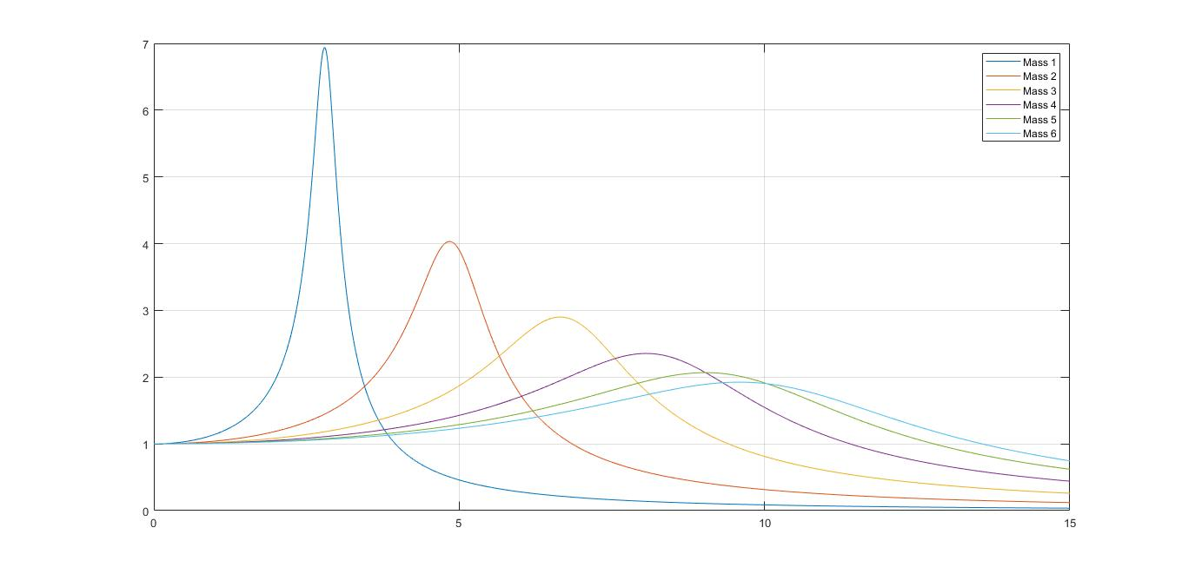
Frequency Response
Zeta value decreasing

Slide 18
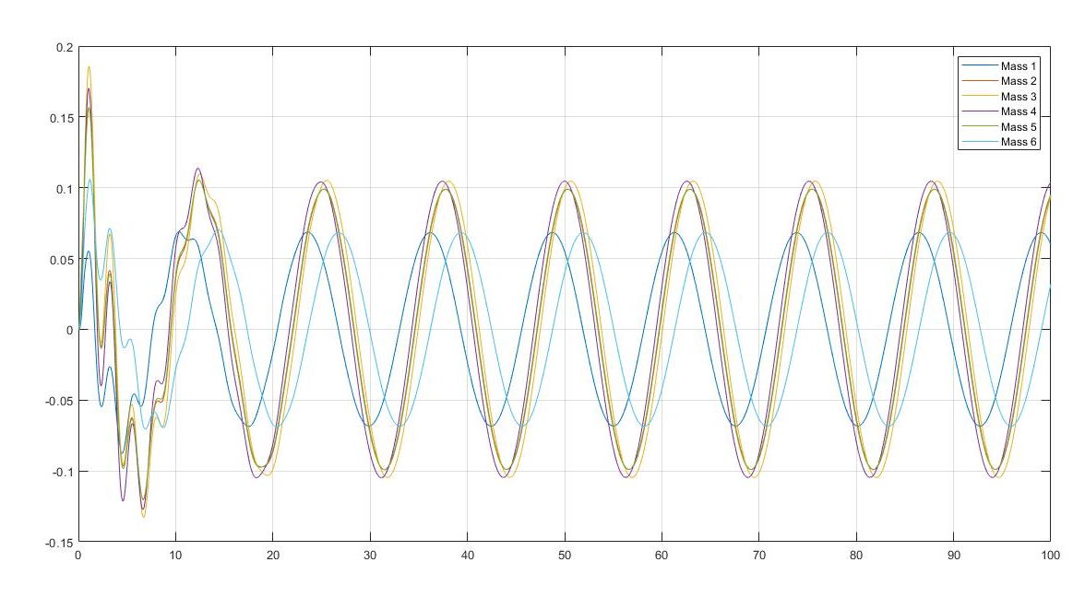
Modal Analysis
Helpful method for decoupling a system of equation of motion

Slide 19
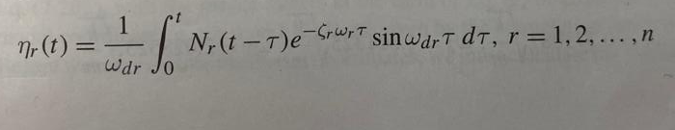
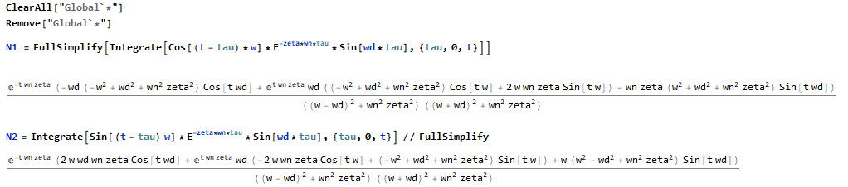
Formulation used
Formulas taken from the course book and computed using the Mathematica tool

Slide 20
Lessons Learnt
This project came out to be very helpful way for me to learn the dynamics of a multi degree of freedom system.
Starting from the basics of single degree of freedom and applying them to MDOF systems.
About coupled and decoupled equations, learnt the importance of responses, about proportional damping.
Energy Method, using Principle of virtual work, Lagrange equations for finding equation of motion.

Slide 21
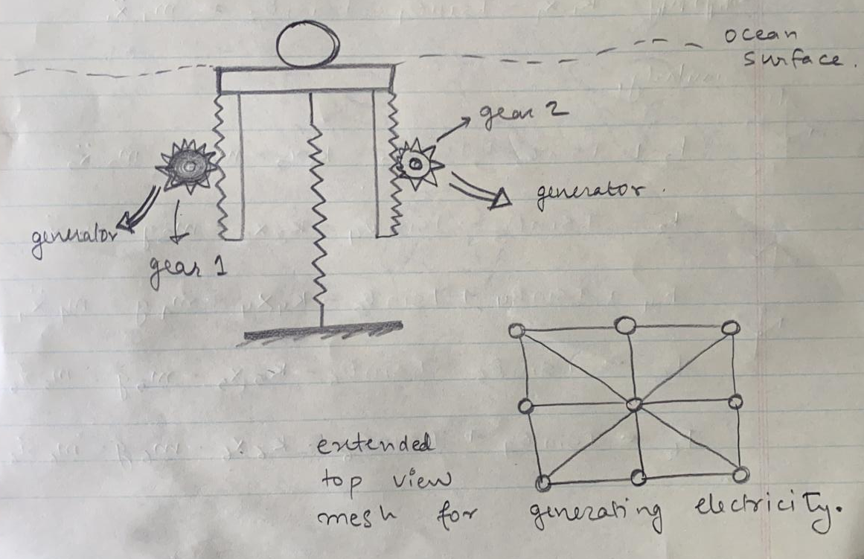
Proof of Concept
2 gears at each side and connected to
Wells turbine which are designed in
such a way that they always rotate in one direction, thus producing electricity.
This idea can be extended to long area covering ocean surface where maximum tidal waves occur, through this huge amount of electricity can be produced.

